Slide 1
Differentiable Fluids
Shrey J. Patel
Advisor: Prof. Ming Lin

Slide 2
Motivation
Understanding fluid dynamics is crucial for many applications

Slide 3
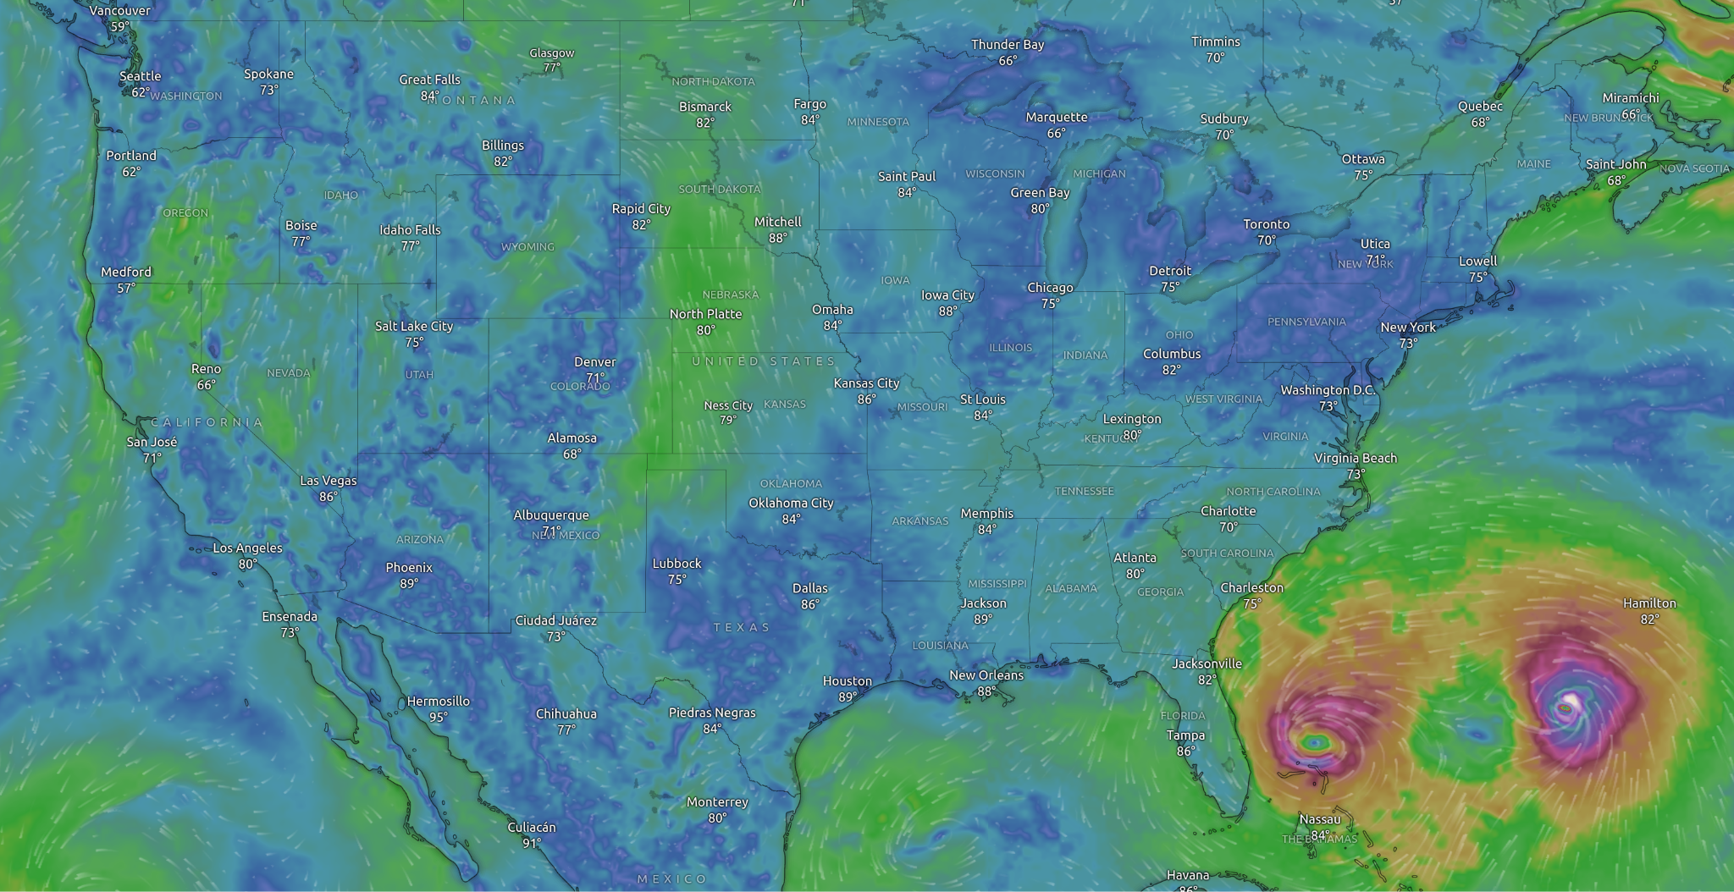
Motivation
Understanding fluid dynamics is crucial for many applications:
  Weather Prediction
Source: [1]
[1] Windy.com

Slide 4
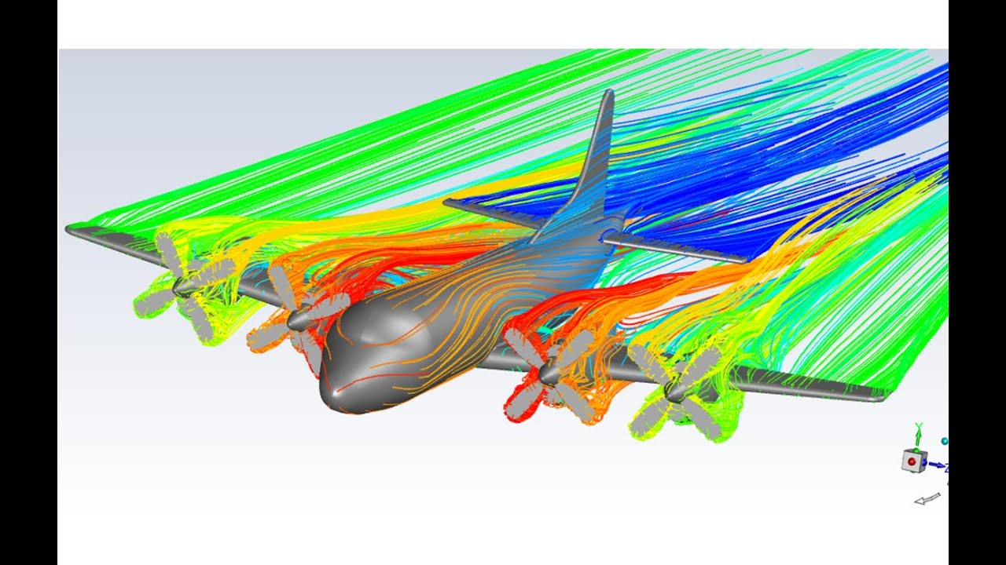
Motivation
Understanding fluid dynamics is crucial for many applications:
  Weather Prediction
  Modeling and Design
Understanding fluid dynamics is crucial for many applications:
  Weather Prediction
Source: [2]
[2] https://www.youtube.com/watch?v=79TbtomUD-o

Slide 5
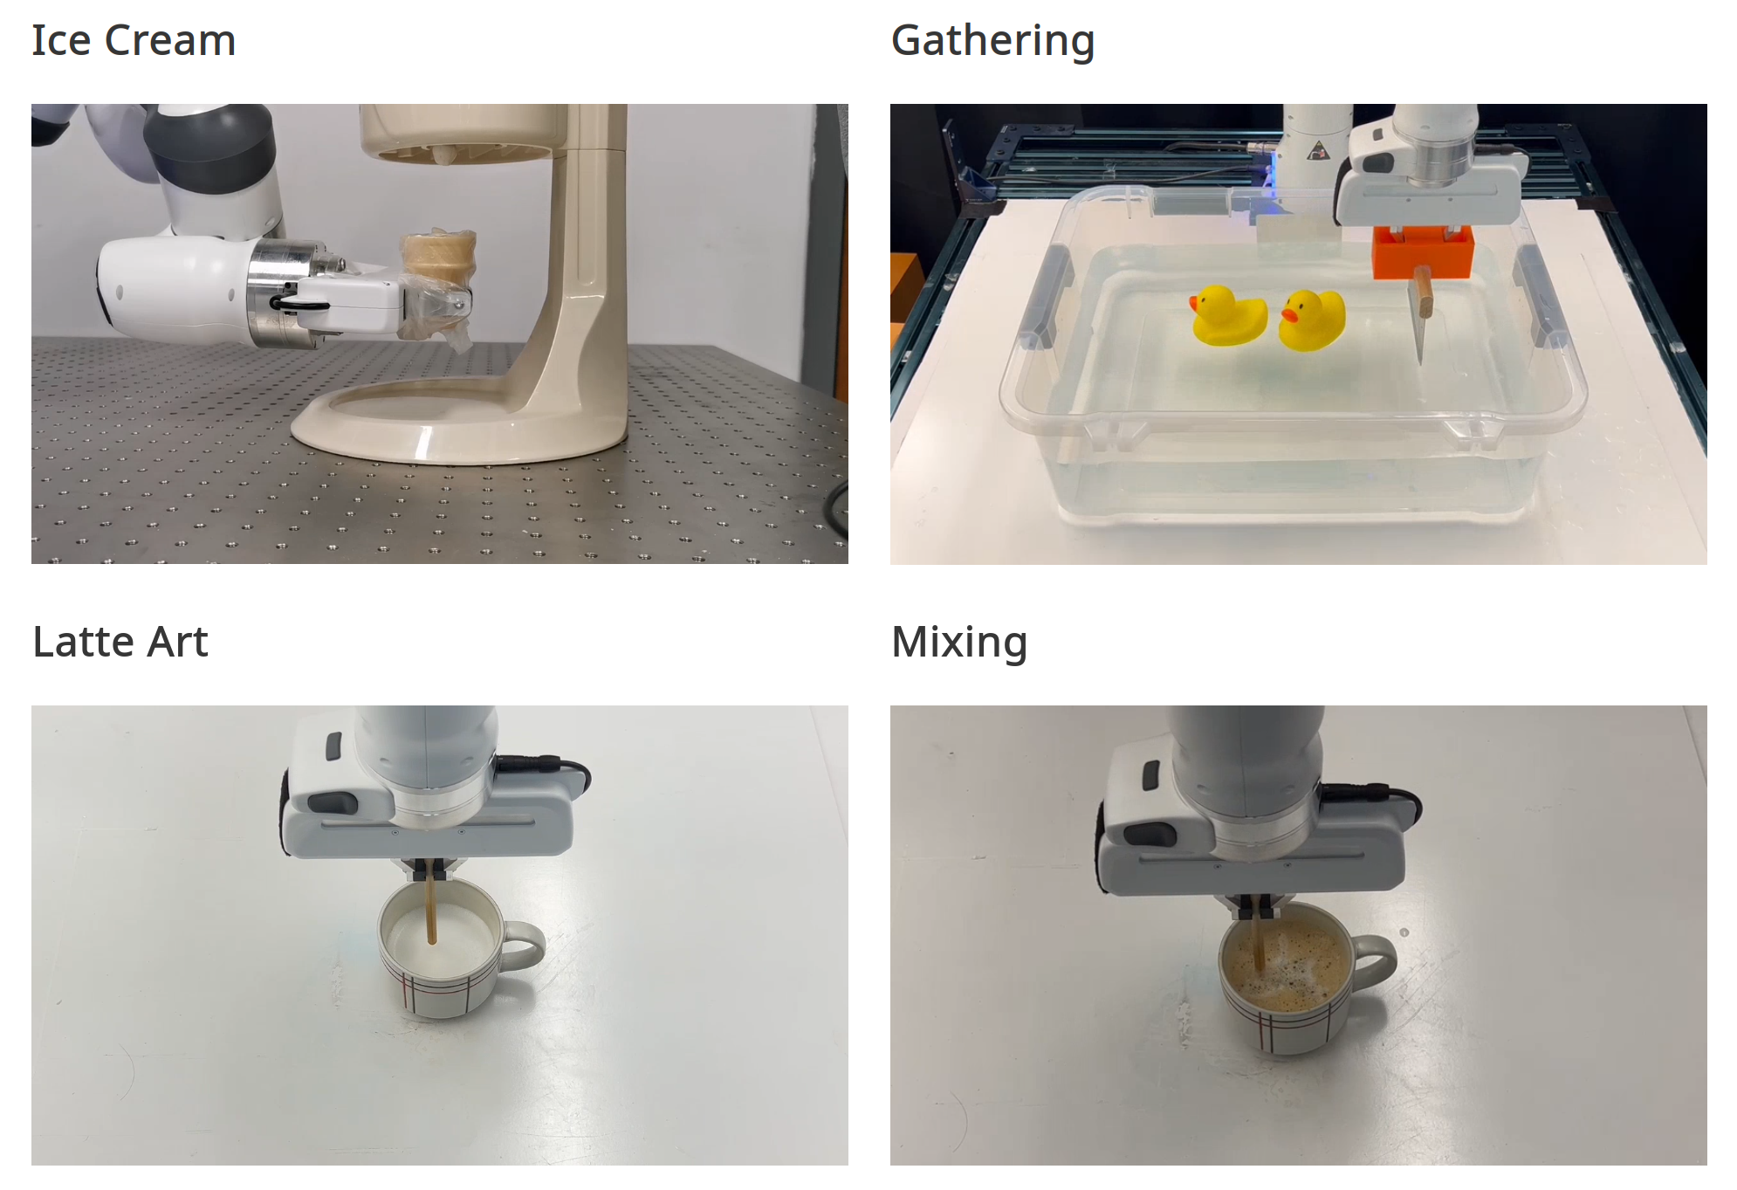
Motivation
Understanding fluid dynamics is crucial for many applications:
  Weather Prediction
  Modeling and Design
  Robotics
Source: [3]
[3] Xian et al. FluidLab: A Differentiable Environment for Benchmarking Complex Fluid Manipulation

Slide 6
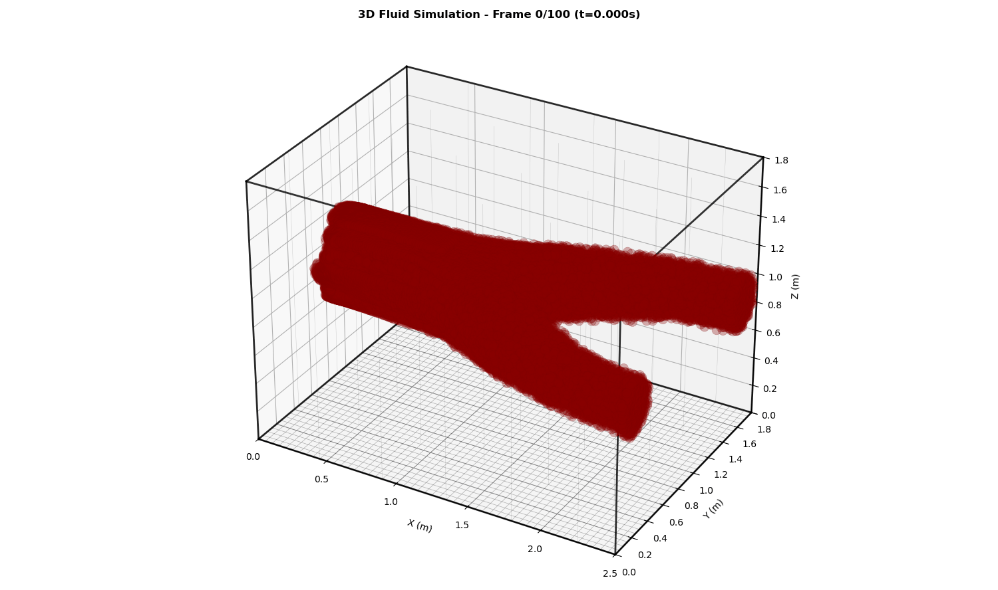
Motivation
Understanding fluid dynamics is crucial for many applications:
  Weather Prediction
  Modeling and Design
  Robotics
  Medical Simulation (Blood Flow)

Slide 7

Motivation
Understanding fluid dynamics is crucial for many applications:
  Weather Prediction
  Modeling and Design
  Robotics
  Medical Simulation (Blood Flow)
  Movies and Games
Sources: [4], [5]
[4] Alexey Stomakhin. The water technology behind Avatar: The Way of Water.
[5] Lesser et al. Loki: a unified multiphysics simulation framework for production

Slide 8
Motivation
Differentiable Fluid Simulation
  Interactions with the physical system/simulation

Slide 9
Motivation
Differentiable Fluid Simulation
  Interactions with the physical system/simulation
  Inverse, control and learning (i.e. optimization) problems can benefit from gradient information

Slide 10
Motivation
Differentiable Fluid Simulation
  Interactions with the physical system/simulation
  Inverse, control and learning (i.e. optimization) problems can benefit from gradient information
  Diff. Sim. provides gradients of optimization objective w.r.t. parameters and inputs

Slide 11
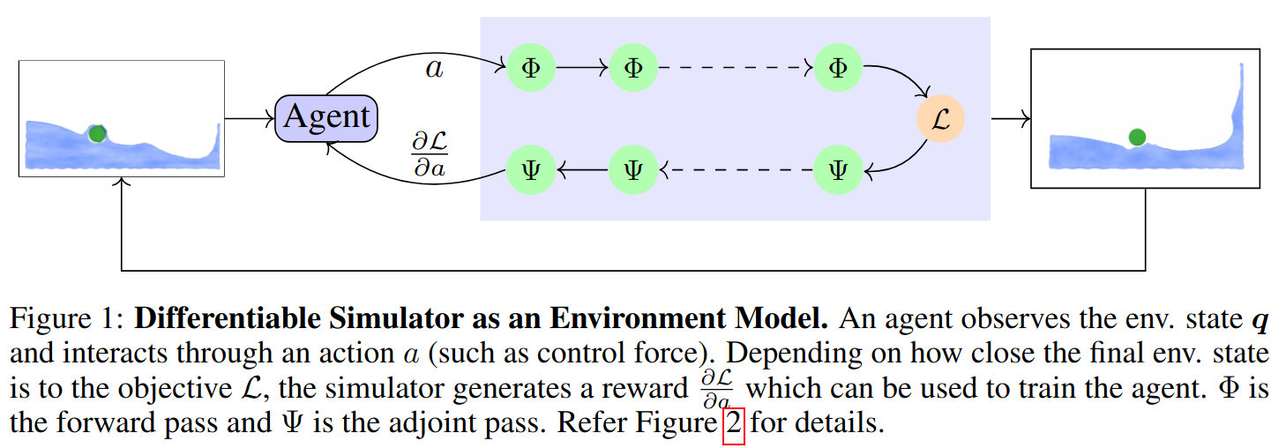
Motivation
Differentiable Fluid Simulation
  Interactions with the physical system/simulation
  Inverse, control and learning (i.e. optimization) problems can benefit from gradient information
  Diff. Sim. provides gradients of optimization objective w.r.t. parameters and inputs

Slide 12
Overview
Fluid Dynamics and Simulation (Φ)
Machine Learning in Fluids
Differentiable Fluid Simulation (Ѱ)

Slide 13
Fluid Dynamics and Simulation

Slide 14
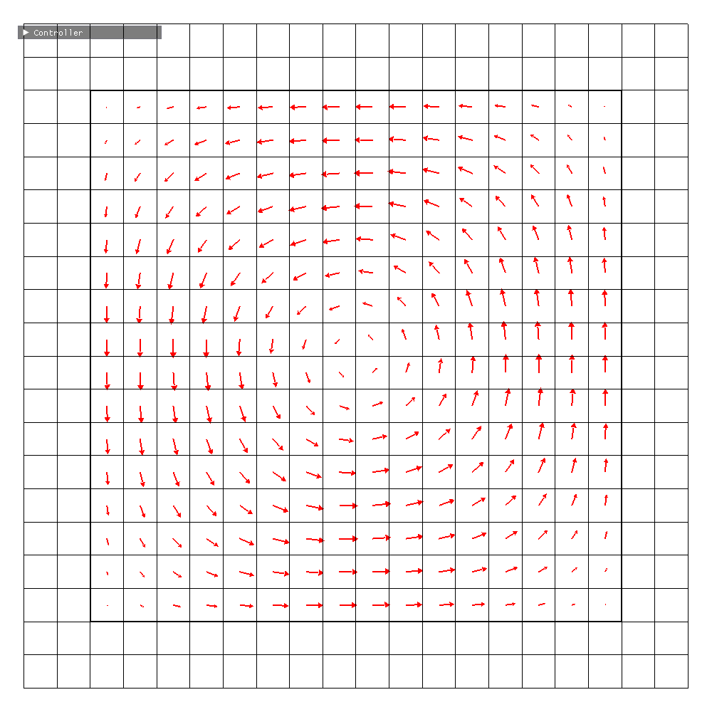
Fluid Characteristics
State: Velocity Field, u

Slide 15
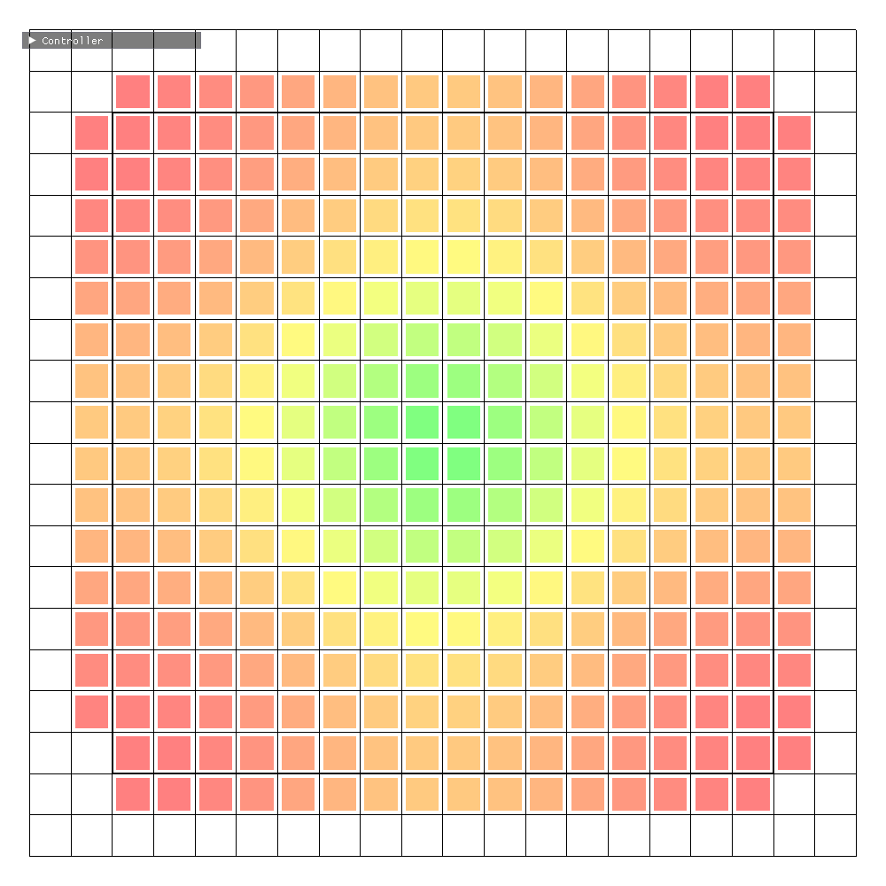
Fluid Characteristics
State: Velocity Field, u
Other Properties:
  Pressure, p
  Density, ⍴
  Viscosity, 𝜈

Slide 16
Fluid Characteristics
State: Velocity Field, u
Other Properties:
  Pressure, p
  Density, ⍴
  Viscosity, 𝜈
We consider inviscid (𝜈 = 0) and incompressible fluids

Slide 17
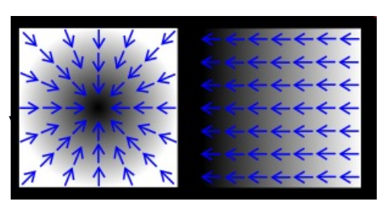
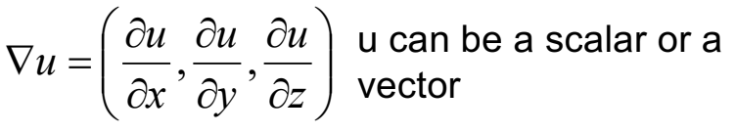
Calculus Review
Gradient (∇): A vector pointing in the direction of the greatest rate of increment

Slide 18
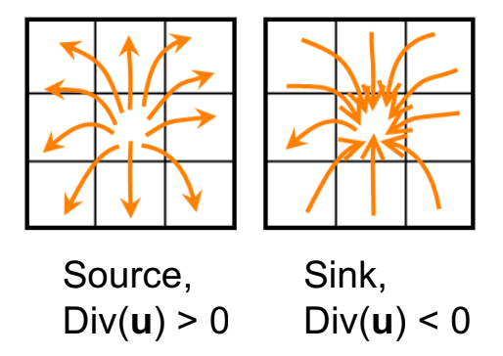
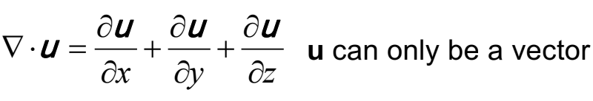
Calculus Review
Gradient (∇): A vector pointing in the direction of the greatest rate of increment
Divergence (∇·): A scalar measuring how vectors converge or diverge at a given location

Slide 19
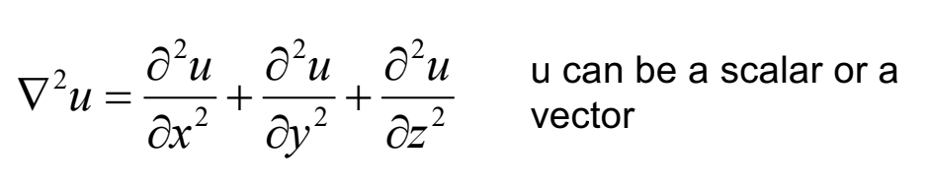
Calculus Review
Laplacian (∇²): Divergence of gradient, a measure of spread

Slide 20
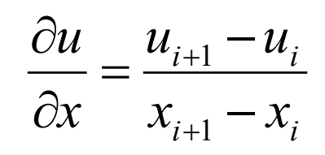
Calculus Review
Laplacian (∇²): Divergence of gradient, a measure of spread
Finite difference derivatives:

Slide 21
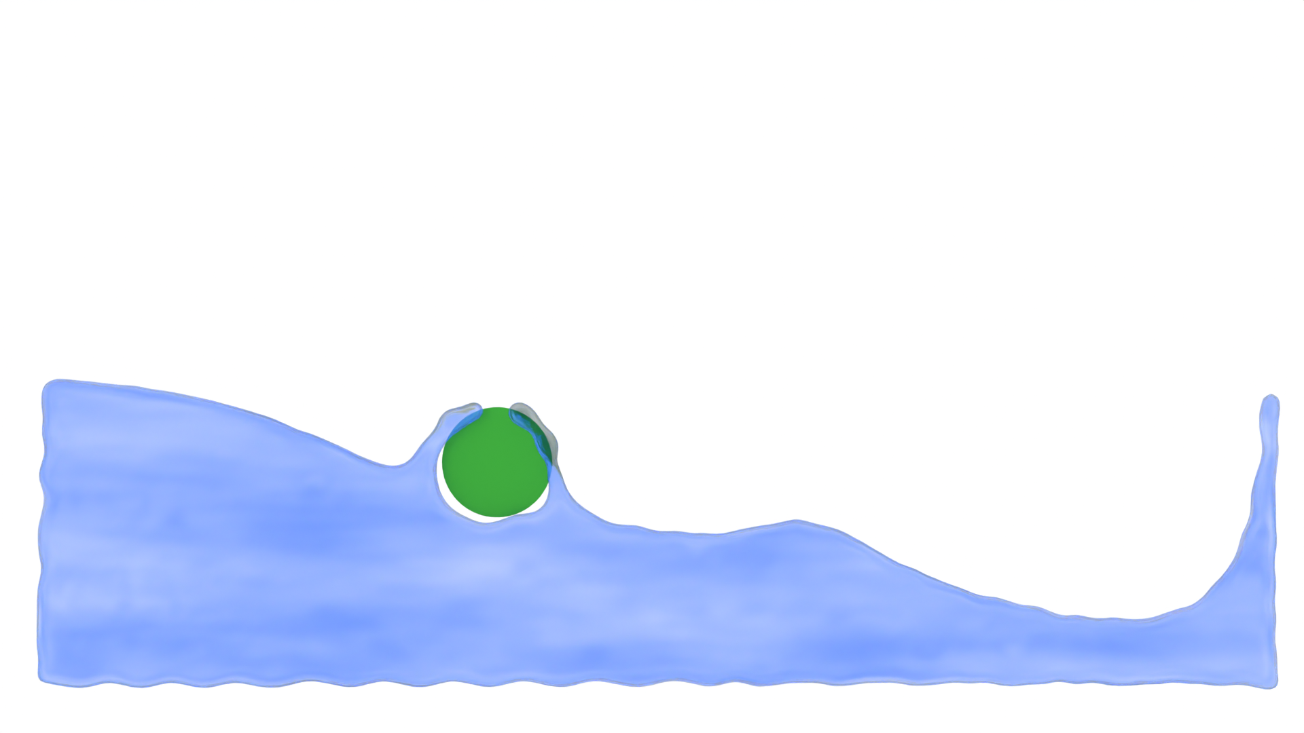
Fluid Discretization: Eulerian or Grid-based
Domain discretized into a grid
Fluid variables are sampled on the grid cells

Slide 22
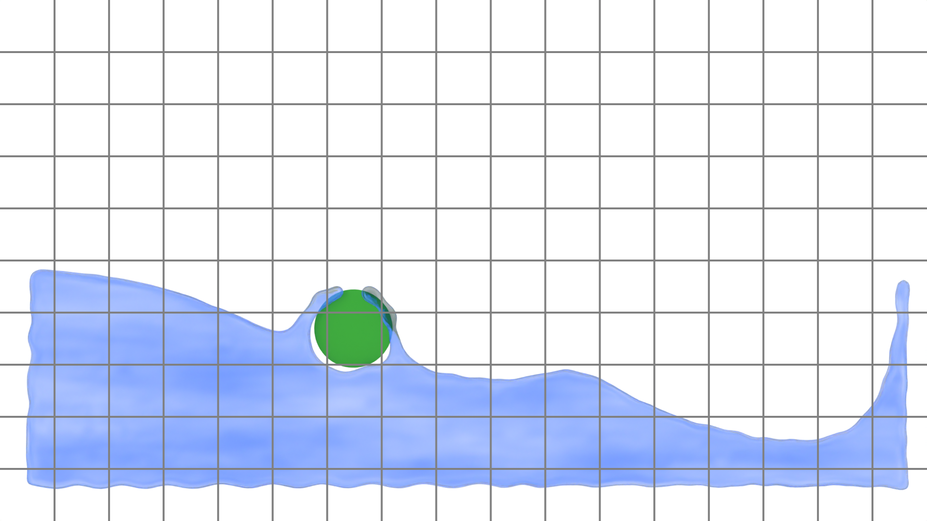

Fluid Discretization: Eulerian or Grid-based
Domain discretized into a grid
Fluid variables are sampled on the grid cells

Slide 23
Fluid Discretization: Eulerian or Grid-based
Domain discretized into a grid
Fluid variables are sampled on the grid cells
Benefits:
  Good approximation of derivatives (grad, div)
  Higher efficiency because of low degrees of freedom

Slide 24
Fluid Discretization: Eulerian or Grid-based
Domain discretized into a grid
Fluid variables are sampled on the grid cells
Benefits:
  Good approximation of derivatives (grad, div)
  Higher efficiency because of low degrees of freedom
Disadvantages:
  Accuracy dependent on resolution

Slide 25
Fluid Discretization: Lagrangian or Particle-based
Fluid treated as discrete particles
Particles carry the local fluid variables, i.e. velocity, density, etc.

Slide 26
Fluid Discretization: Lagrangian or Particle-based
Fluid treated as discrete particles
Particles carry the local fluid variables, i.e. velocity, density, etc.

Slide 27
Fluid Discretization: Lagrangian or Particle-based
Fluid treated as discrete particles
Particles carry the local fluid variables, i.e. velocity, density, etc.
Benefits:
  High accuracy because of high degrees of freedom
  Better surface handling, yielding results with superior visual quality

Slide 28
Fluid Discretization: Lagrangian or Particle-based
Fluid treated as discrete particles
Particles carry the local fluid variables, i.e. velocity, density, etc.
Benefits:
  High accuracy because of high degrees of freedom
  Better surface handling, yielding results with superior visual quality
Disadvantages
  No connectivity information, ill-defined topology
  Difficult to enforce constraints

Slide 29
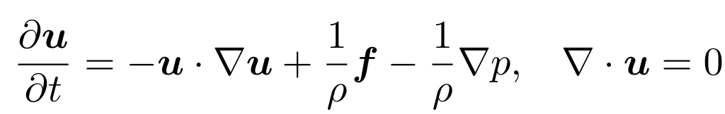
Fluid Dynamics
Dynamics governed by Navier-Stokes equations:

Slide 30
Fluid Dynamics
Dynamics governed by Navier-Stokes equations:
Conservation of Momentum

Slide 31
Fluid Dynamics
Dynamics governed by Navier-Stokes equations:
Conservation of Mass

Slide 32
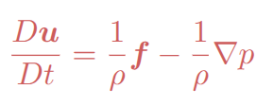
Fluid Dynamics
Dynamics governed by Navier-Stokes equations:
Advection:
Accounts for movement of fluid quantities: density, velocity, etc.
Only in grid-based methods
In particle based methods, this is replaced by a material derivative Du/Dt

Slide 33
Fluid Dynamics
Dynamics governed by Navier-Stokes equations:
External Force:
Gravity, Control Forces, etc.

Slide 34
Fluid Dynamics
Dynamics governed by Navier-Stokes equations:
Pressure:
Enforces incompressibility and other boundary conditions
Responsible for coupling fluids with other entities in the simulation

Slide 35
Other boundary conditions
Static boundary: No penetration allowed
Free Slip: Tangential velocity allowed
No Slip: Tangential velocity must be zero

Slide 36
Other boundary conditions
Static boundary: No penetration allowed
Free Slip: Tangential velocity allowed
No Slip: Tangential velocity must be zero
Free Surface: Water-air boundary, p = 0

Slide 37
Other boundary conditions
Dynamic Boundary: No penetration, tangential velocity equal to the boundary
Static boundary: No penetration allowed
Free Slip: Tangential velocity allowed
No Slip: Tangential velocity must be zero
Free Surface: Water-air boundary, p = 0

Slide 38
Numerical Solution
Operator splitting: All terms are solved separately

Slide 39


Numerical Solution
Operator splitting: All terms are solved separately
1.
Advection

Slide 40

Numerical Solution
Operator splitting: All terms are solved separately
2.
Advection
External
Force

Slide 41

Numerical Solution
Operator splitting: All terms are solved separately
3.
Advection
External
Force
Pressure
Solve

Slide 42
Numerical Solution
Operator splitting: All terms are solved separately
Allows for separate treatment of all terms: numerical method, parameters, analysis, etc.

Slide 43
Advection
Transport/Convection of a physical quantity by a background vector field

Slide 44



Advection
Transport/Convection of a physical quantity by a background vector field
t
t + Δt

Slide 45
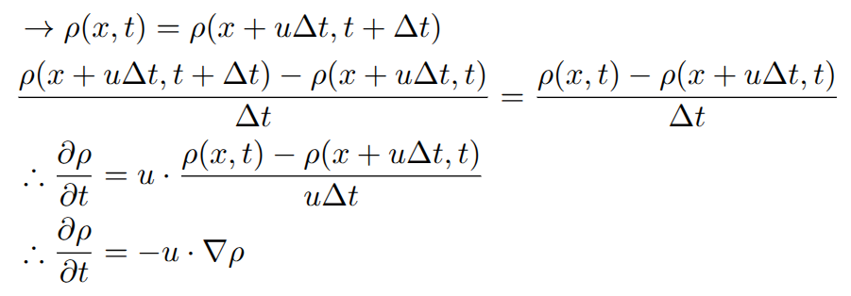
Advection
Transport/Convection of a physical quantity by a background vector field
t
t + Δt

Slide 46

Advection
Transport/Convection of a physical quantity by a background vector field
Methods of solving:
Forward Euler:
t
t + Δt

Slide 47
Advection
Transport/Convection of a physical quantity by a background vector field
Methods of solving:
Forward Euler:
t
t + Δt
Unstable!

Slide 48
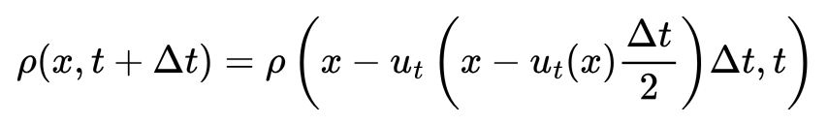
Advection
Transport/Convection of a physical quantity by a background vector field
Methods of solving:
Semi-lagrangian
t
t + Δt

Slide 49
Projection/Pressure Solve
Enforces incompressibility (mass/volume conservation) on the fluid

Slide 50
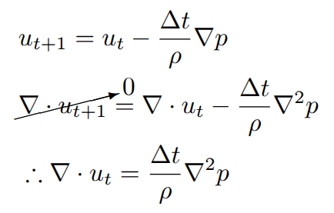
Projection/Pressure Solve
Enforces incompressibility (mass/volume conservation) on the fluid
Continuous

Slide 51



Projection/Pressure Solve
Enforces incompressibility (mass/volume conservation) on the fluid
Continuous
MAC Grid[6]
[6] Harlow and Welch. Numerical Calculation of Time‐Dependent Viscous Incompressible Flow of Fluid with Free Surface

Slide 52
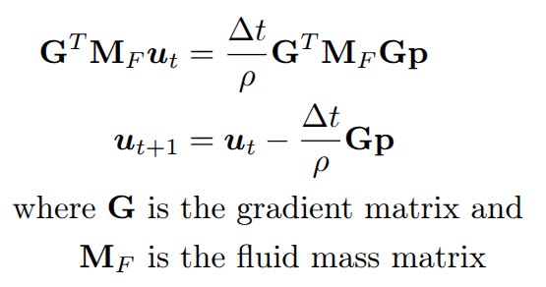
Projection/Pressure Solve
Enforces incompressibility (mass/volume conservation) on the fluid
Continuous
Discrete
MAC Grid[6]
[6] Harlow and Welch. Numerical Calculation of Time‐Dependent Viscous Incompressible Flow of Fluid with Free Surface

Slide 53
Solid(Rigid)-Fluid Coupling
Interactions with fluids requires modeling coupling dynamics. Pressure acts as the point of coupling since it can exert force both ways (solid -> fluid and fluid -> solid)

Slide 54
Solid-Fluid Coupling
Interactions with fluids requires modeling coupling dynamics. Pressure acts as the point of coupling since it can exert force both ways (solid -> fluid and fluid -> solid)
Pressure p enforces non-penetration condition, i.e. (u - v) . n >= 0

Slide 55
Solid-Fluid Coupling
Rigid Body:
State:
  Position (3 dof, 6 dof), x
  Velocity (3 dof, 6 dof), v

Slide 56
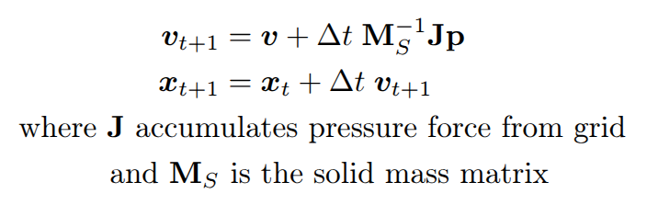
Solid-Fluid Coupling
Rigid Body:
State:
  Position (3 dof, 6 dof), x
  Velocity (3 dof, 6 dof), v
Dynamics:

Slide 57
Numerical Solution (Earlier)
Advection
External
Force
Pressure
Solve

Slide 58



Numerical Solution (with coupling)
Advection
External
Force
Pressure
Solve
RBD Time
Integration

Slide 59
Projection/Pressure Solve
Enforces incompressibility and solid-fluid boundary condition

Slide 60
Projection/Pressure Solve
Enforces incompressibility and solid-fluid boundary condition
Variational Interpretation [7]: Pressure minimizes the total kinetic energy of the system after the projection step
[7] Batty et al. A Fast Variational Framework for Accurate Solid-Fluid Coupling

Slide 61
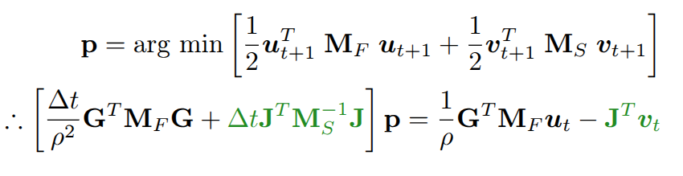
Projection/Pressure Solve
Enforces incompressibility and solid-fluid boundary condition
Variational Interpretation [7]: Pressure minimizes the total kinetic energy of the system after the projection step
[7] Batty et al. A Fast Variational Framework for Accurate Solid-Fluid Coupling

Slide 62
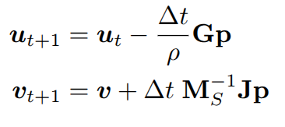
Projection/Pressure Solve
Enforces incompressibility and solid-fluid boundary condition
Variational Interpretation [7]: Pressure minimizes the total kinetic energy of the system after the projection step
[7] Batty et al. A Fast Variational Framework for Accurate Solid-Fluid Coupling

Slide 63

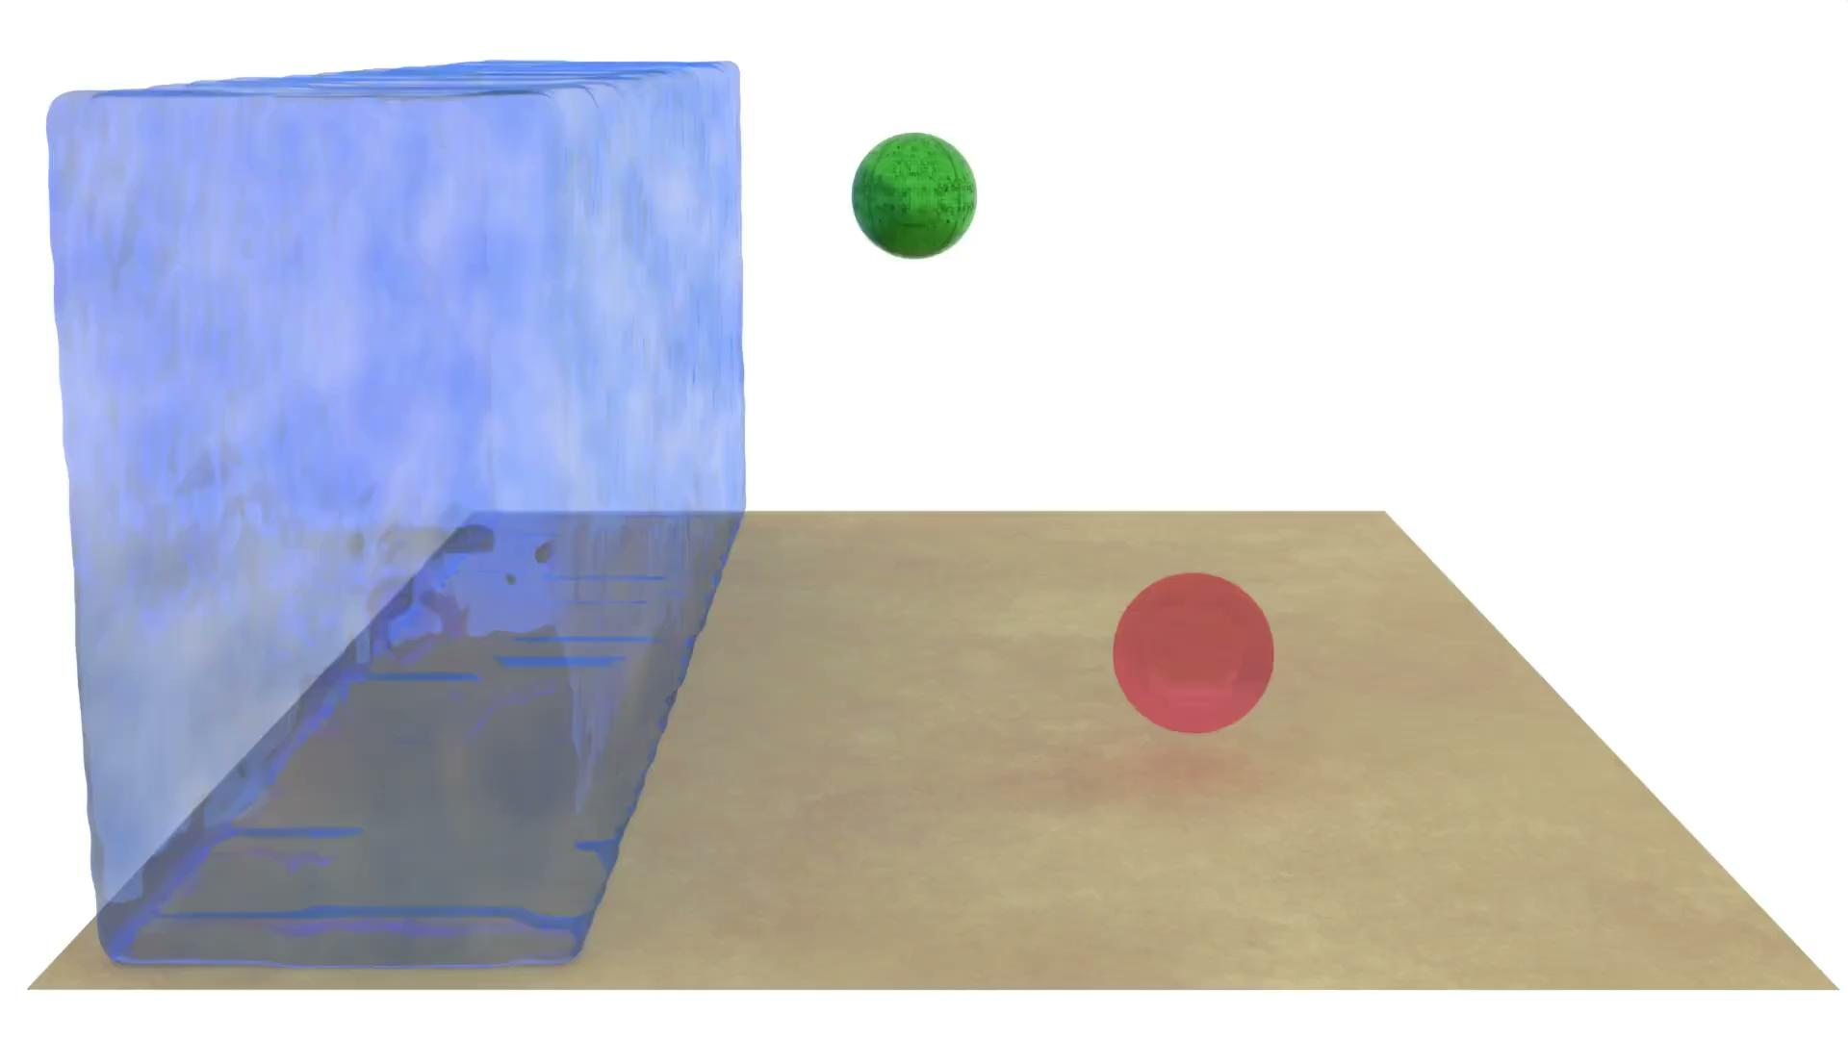
Results
2D
3D

Slide 64
Limitations
Solving Navier-Stokes can be expensive, both in runtime and memory
Arbitrary accuracy is not guaranteed without also increasing resource cost
Hard to account for unmodeled phenomena

Slide 65
Limitations
Solving Navier-Stokes can be expensive, both in runtime and memory
Arbitrary accuracy is not guaranteed without also increasing resource cost
Hard to account for unmodeled phenomena
Can we leverage machine learning as a surrogate/accelerator for predicting next states through inference?

Slide 66
Machine Learning for Fluids

Slide 67
ML for Fluids
ML models can act as ‘surrogates’ for fluid simulators
Instead of solving the PDE, learn from data

Slide 68
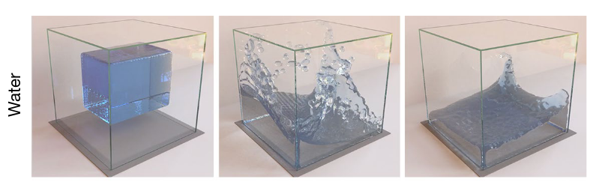
Applications: Prediction
Source: [9]
https://sites.google.com/view/learning-to-simulate/home#h.p_hjnaJ6k8y0wo
[9] Sanchez-Gonzales et al. Learning to Simulate Complex Physics with Graph Networks

Slide 69
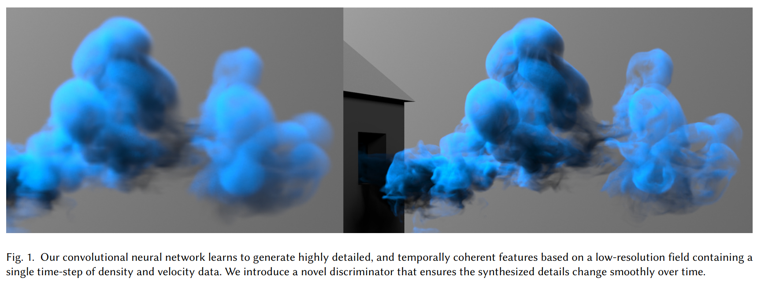
Applications: Super-resolution
Predicting high resolution from low resolution
Source: [8]
[8] Xie et al. tempoGAN: A Temporally Coherent, Volumetric GAN for Super-resolution Fluid Flow

Slide 70
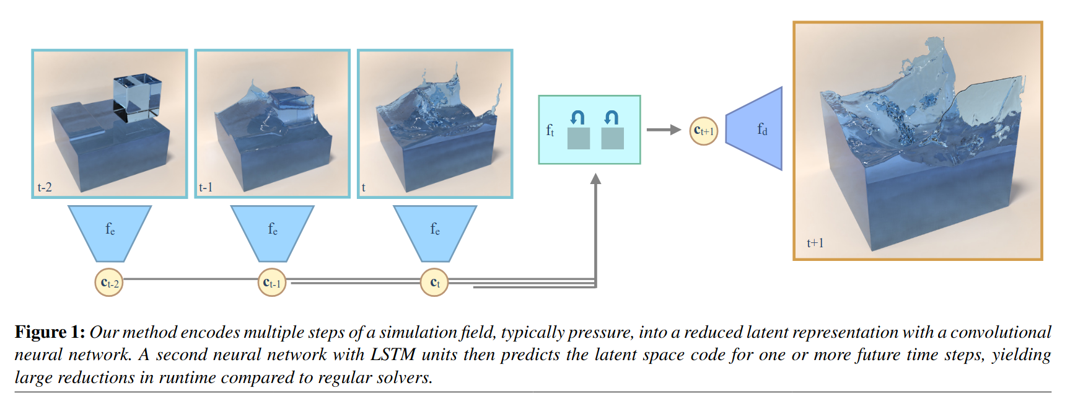
Applications: Compression
Encode physical states into low-dimensional latent space for reduced runtime and storage without compromising accuracy
Source: [9]
[9] Wiewel et al. Latent Space Physics: Towards Learning the Temporal Evolution of Fluid Flow

Slide 71
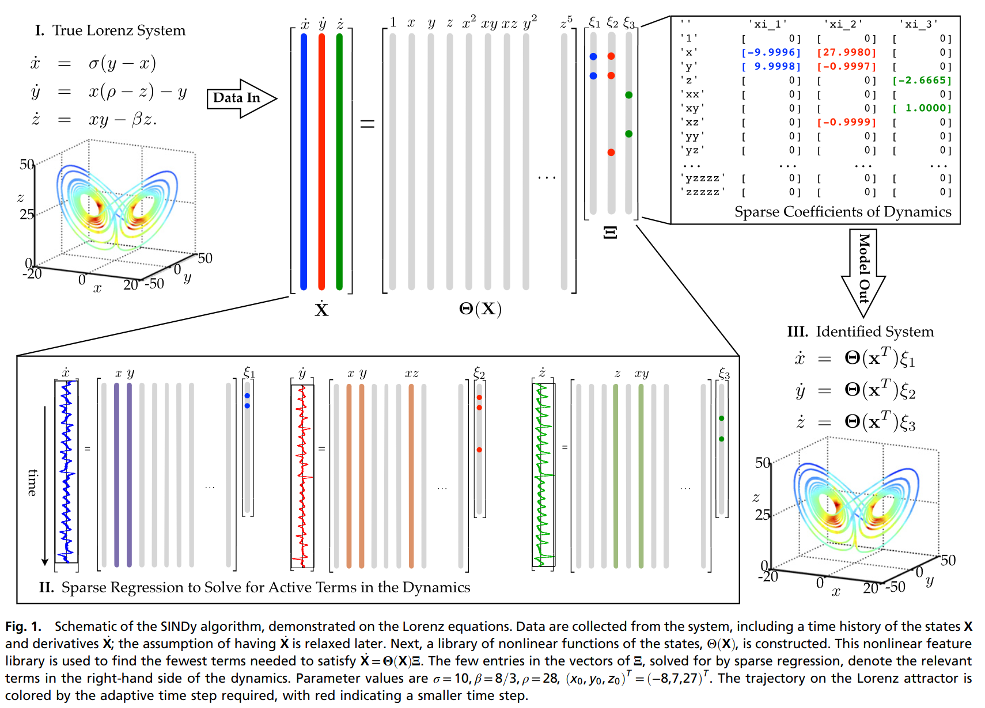
Applications: Modeling
Unmodeled phenomena can be learned from data. Important step towards enabling intelligent agents for scientific discovery
Source: [11]
[11] Brunton et al. Discovering governing equations from data by sparse identification of nonlinear dynamical systems

Slide 72
ML for Fluids
ML models can act as ‘surrogates’ for fluid simulators
Instead of solving the PDE, learn from data
But,

Slide 73
ML for Fluids
ML models can act as ‘surrogates’ for fluid simulators
Instead of solving the PDE, learn from data
But,
Require high-quality data, where physical laws and boundary conditions hold

Slide 74
ML for Fluids
ML models can act as ‘surrogates’ for fluid simulators
Instead of solving the PDE, learn from data
But,
Require high-quality data, where physical laws and boundary conditions hold
Require a lot of it, especially for high-dimensional systems like fluids

Slide 75
Physics Informed Neural Networks (PINNs) [10]
[10] Raissi et al. Physics-informed neural networks: A deep learning framework for solving forward and inverse problems involving nonlinear partial differential equations

Slide 76

Physics Informed Neural Networks (PINNs) [10]
Physical Laws (PDEs) and Boundary Conditions included as constraints in NN loss
[10] Raissi et al. Physics-informed neural networks: A deep learning framework for solving forward and inverse problems involving nonlinear partial differential equations

Slide 77
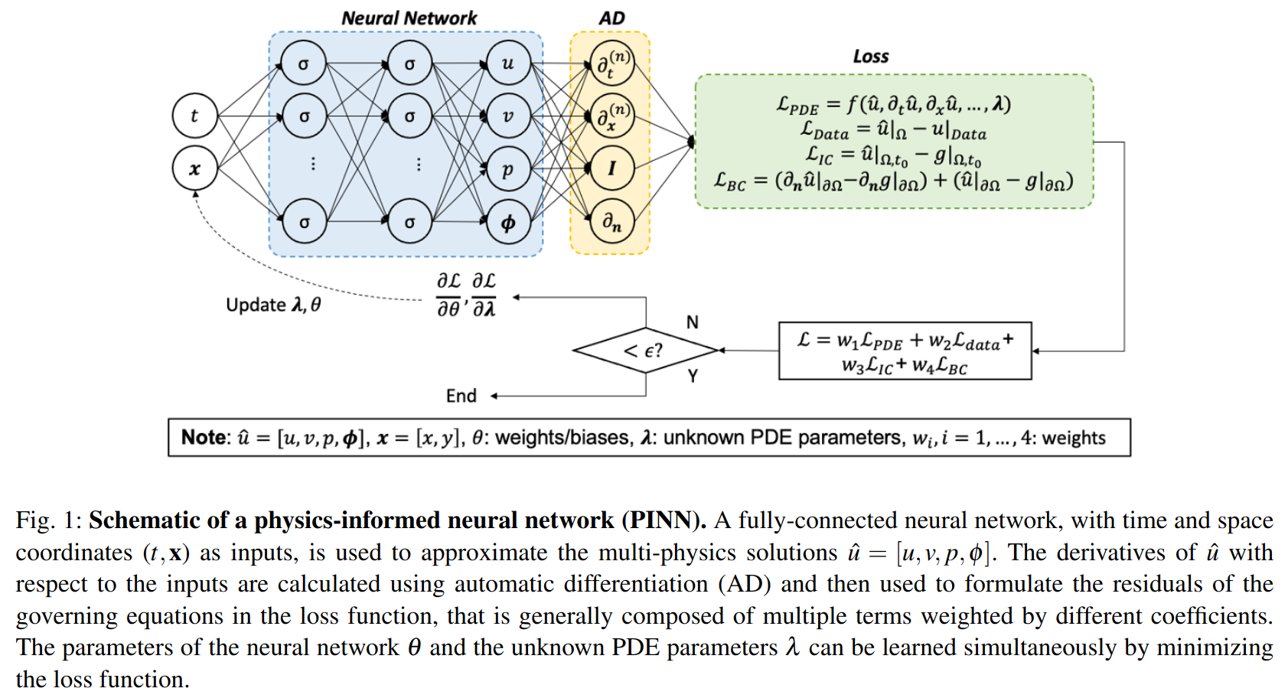
Physics Informed Neural Networks (PINNs) [10]
Source: [12]
[10] Raissi et al. Physics-informed neural networks: A deep learning framework for solving forward and inverse problems involving nonlinear partial differential equations
[12] Cai et al. Physics-informed neural networks (PINNs) for fluid mechanics: A review

Slide 78
Physics Informed Neural Networks (PINNs) [10]
Physical Laws (PDEs) and Boundary Conditions included as constraints in NN loss
Advantage: Need lesser, sparser data
[10] Raissi et al. Physics-informed neural networks: A deep learning framework for solving forward and inverse problems involving nonlinear partial differential equations

Slide 79
Physics Informed Neural Networks (PINNs) [10]
Physical Laws (PDEs) and Boundary Conditions included as constraints in NN loss
Advantage: Need lesser, sparser data
Disadvantage: Loss terms are still loose constraints, which may not hold exactly, and it is hard to reason about them
[10] Raissi et al. Physics-informed neural networks: A deep learning framework for solving forward and inverse problems involving nonlinear partial differential equations

Slide 80
Limitations
Reliance on high quality data, real or synthetic
Large training costs, because of high-dimensionality of physical states
Hard to reason about accuracy and stability because of black-box nature
Hard to enforce physical laws and constraints just from loss functions
Rare, corner cases might not be represented adequately

Slide 81
DRiFT: Differentiable Grid-Based Rigid-Fluid Coupling For Training And Control
Shrey Patel, Samuel Audia, Heechan Yoon, Bo Zhu, Rahul Narain, Ming C. Lin (in submission to ICLR 2026)

Slide 82
Motivation
Both ML models and Simulators are functions

Slide 83
Motivation
Both ML models and Simulators are functions
Data
Equation

Slide 84
Motivation
Both ML models and Simulators are functions
Data
Equation
ML models

Slide 85
Motivation
Both ML models and Simulators are functions
Data
Equation
ML models
Simulators

Slide 86
Motivation
Both ML models and Simulators are functions
Data
Equation
ML models
PINNs
Simulators

Slide 87
Motivation
Both ML models and Simulators are functions
Data-driven models: High training time, low inference time
Equation based models: No/Low training time, high inference time

Slide 88
Motivation
Both ML models and Simulators are functions
Data-driven models: High training time, low inference time
Equation based models: No/Low training time, high inference time
What if we combine both?

Slide 89
Motivation
Simulator as a layer in neural networks
Requirement: Gradients

Slide 90
Gradient Computation Methods
Auto-differentiation (PhiFlow [13])
  Advantages: General, and requires low effort
  Disadvantages: Slower, due to overhead from message passing, maintaining extra info., etc.
[13] Holl et al. PhiFlow: Differentiable Simulations for PyTorch, TensorFlow and Jax

Slide 91
Gradient Computation Methods
Auto-differentiation (PhiFlow [13])
  Advantages: General, and requires low effort
  Disadvantages: Slower, due to overhead from message passing, maintaining extra info., etc.
Analytic Differentiation (differentiating the numerical solution directly)
  Advantages: Faster, easier to reason about accuracy and stability
  Disadvantages: Lot of effort, error prone
[13] Holl et al. PhiFlow: Differentiable Simulations for PyTorch, TensorFlow and Jax

Slide 92
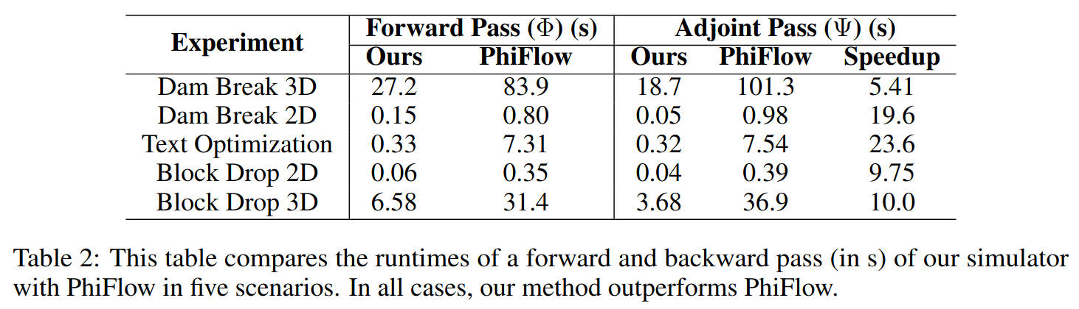
Results: Comparison with Auto-Differentiation (PhiFlow[13])
[13] Holl et al. PhiFlow: Differentiable Simulations for PyTorch, TensorFlow and Jax

Slide 93


Numerical Solution
Advection
External
Force
Pressure
Solve
RBD Time
Integration
Φ

Slide 94
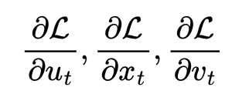
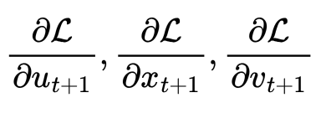
Gradient Computation
Advection
External
Force
Pressure
Solve
RBD Time
Integration
Φ
Ψ

Slide 95
Gradient Computation
Advection
External
Force
Pressure
Solve
RBD Time
Integration
Φ
Ψ

Slide 96
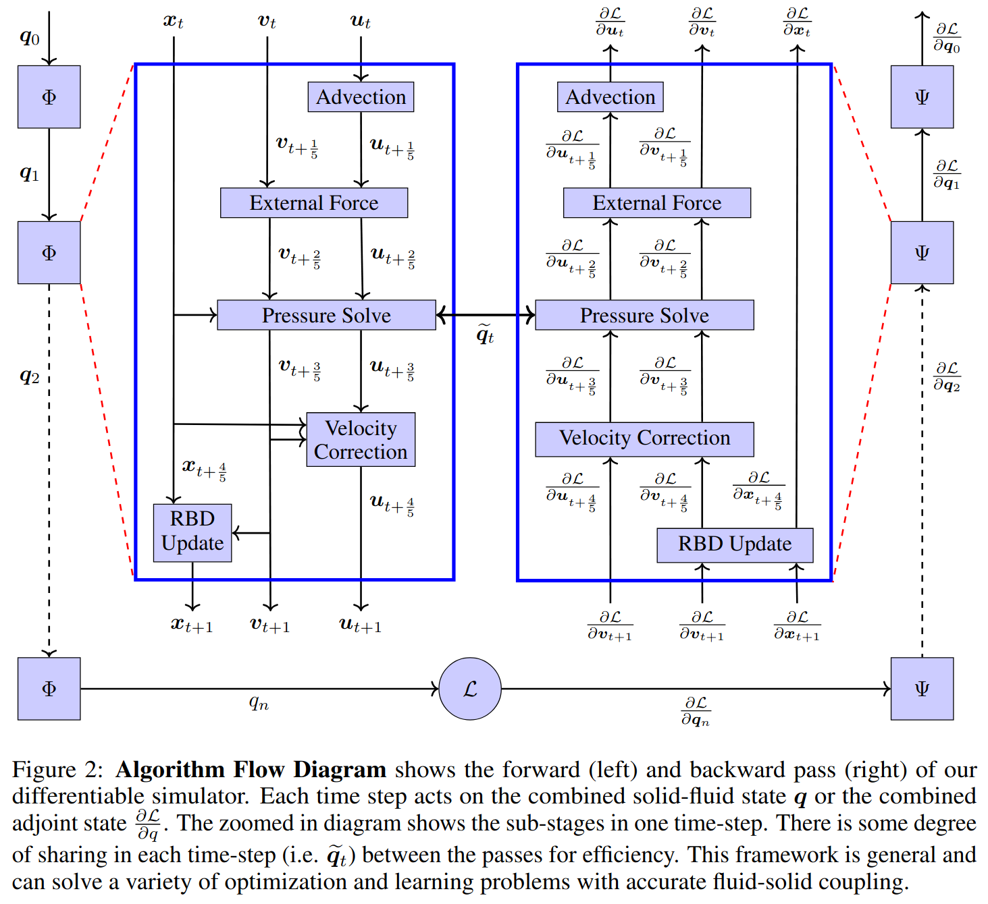
Differentiating through time

Slide 97
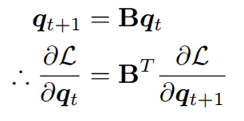
Differentiating the Numerical Solution
The steps, advection, external force and rigid body time integration can be represented as a matrix-vector product, whose gradient calculation is straightforward

Slide 98
Differentiating the Numerical Solution
The steps, advection, external force and rigid body time integration can be represented as a matrix-vector product, whose gradient calculation is straightforward
Slightly more involved for advection, since B depends on q_{t}

Slide 99
Differentiating the Pressure Solve
We use adjoint method[14] for computing gradients of pressure solve
[14] Lions et al. Optimal Control of Systems Governed by Partial Differential Equations

Slide 100
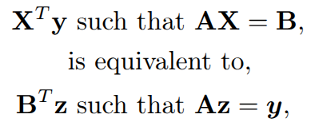
Differentiating the Pressure Solve
We use adjoint method[14] for computing gradients of pressure solve
[14] Lions et al. Optimal Control of Systems Governed by Partial Differential Equations

Slide 101
Differentiating the Pressure Solve
We use adjoint method[14] for computing gradients of pressure solve
Advantage: Massively reduces the cost of computing the solution of the linear system. (If X has n columns, then n linear solves would be required earlier)
[14] Lions et al. Optimal Control of Systems Governed by Partial Differential Equations

Slide 102
Differentiating the Pressure Solve
We use adjoint method[14] for computing gradients of pressure solve
Advantage: Massively reduces the cost of computing the solution of the linear system. (If X has n columns, then n linear solves would be required earlier)
In our case, matrix X is dp/dq and vector z is a local variable, ‘adjoint pressure’
[14] Lions et al. Optimal Control of Systems Governed by Partial Differential Equations

Slide 103
Differentiating the Pressure Solve
Pressure
Solve

Slide 104
Differentiating the Pressure Solve
Pressure
Solve
Adjoint Pressure
Solve

Slide 105
Differentiating the Pressure Solve
Pressure
Solve
Adjoint Pressure
Solve

Slide 106
Differentiating the Pressure Solve
Pressure
Solve
Adjoint Pressure
Solve
Adjoint Pressure

Slide 107
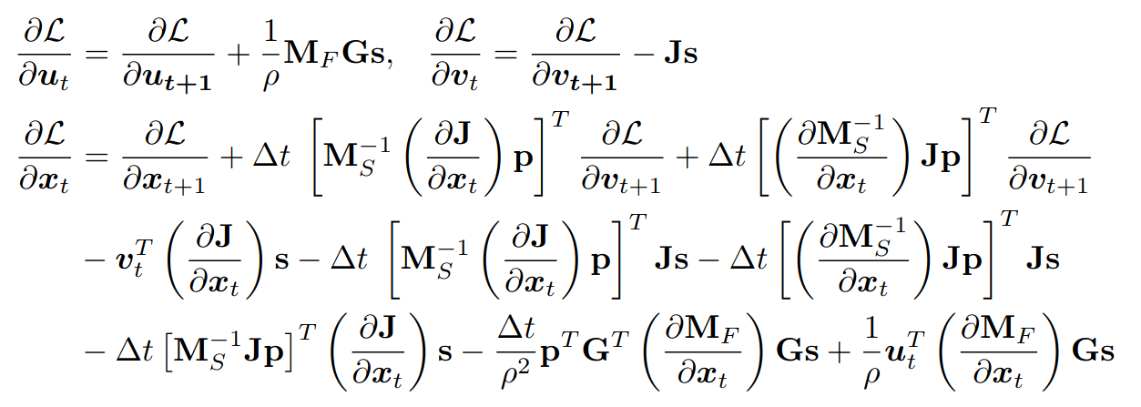
Differentiating the Pressure Solve
Pressure
Solve
Adjoint Pressure
Solve

Slide 108
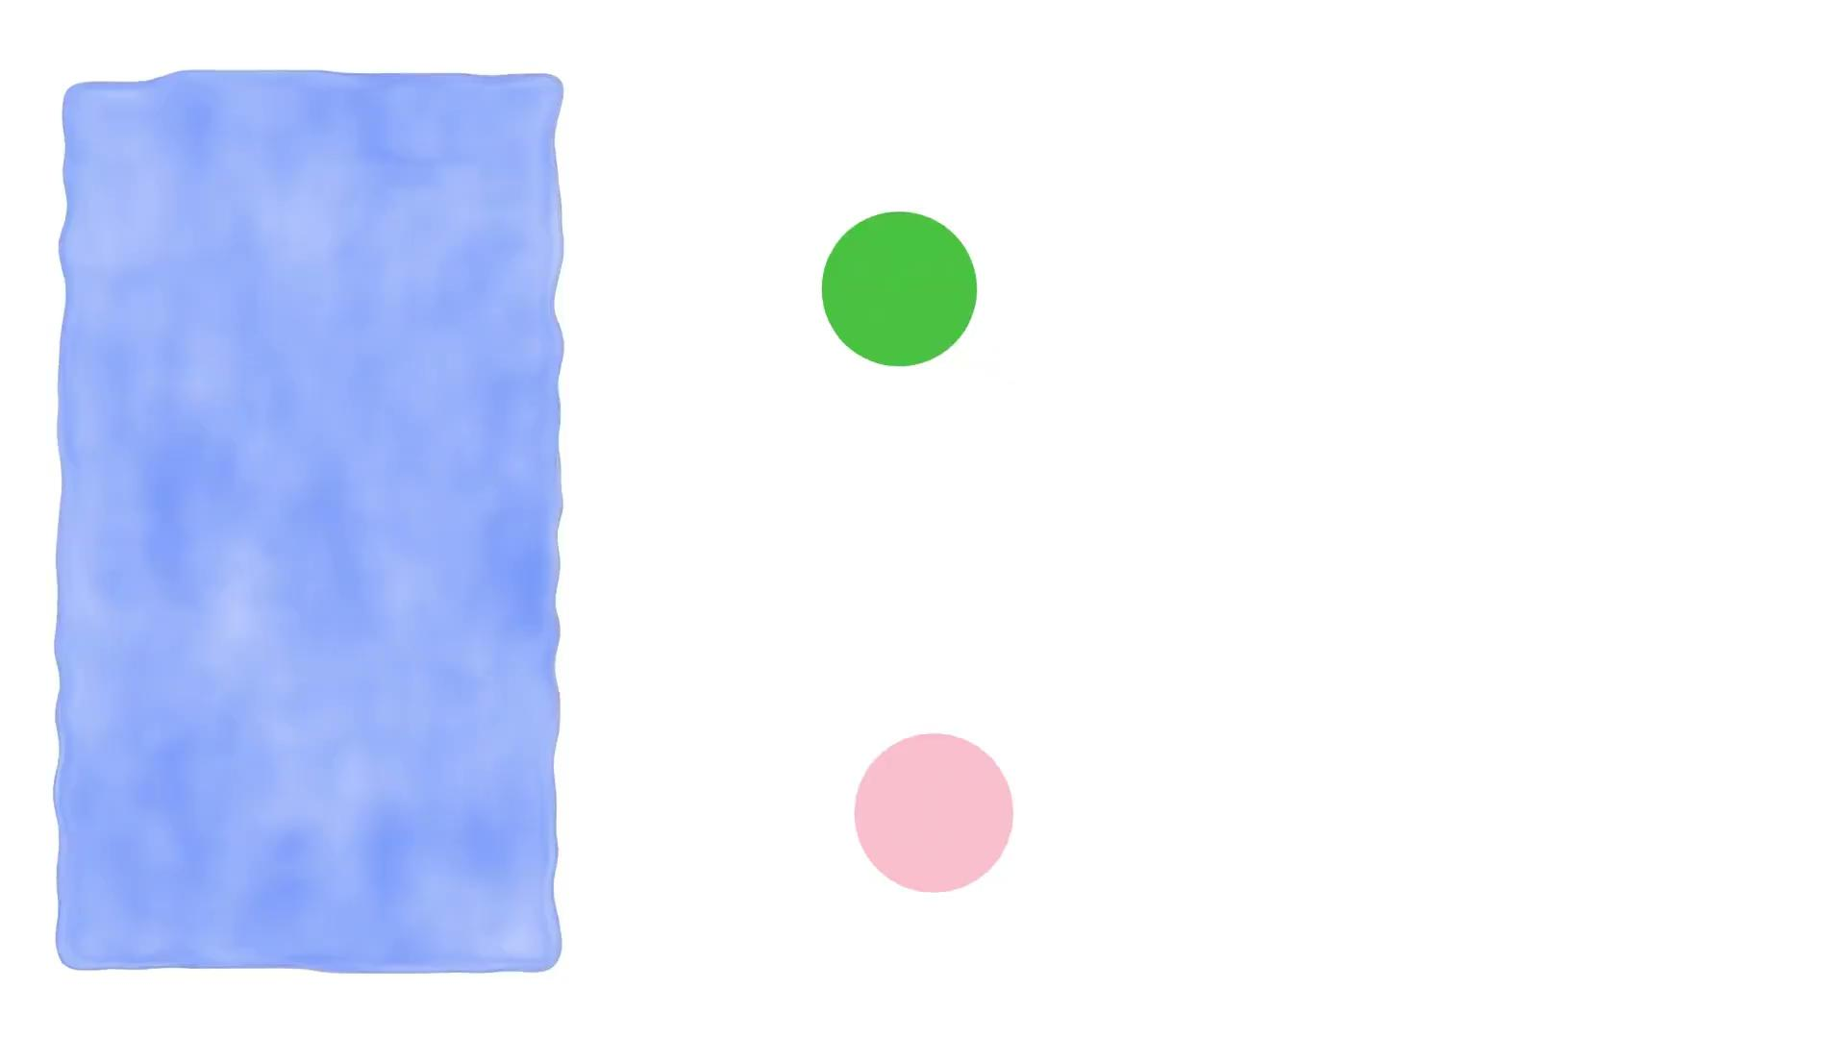
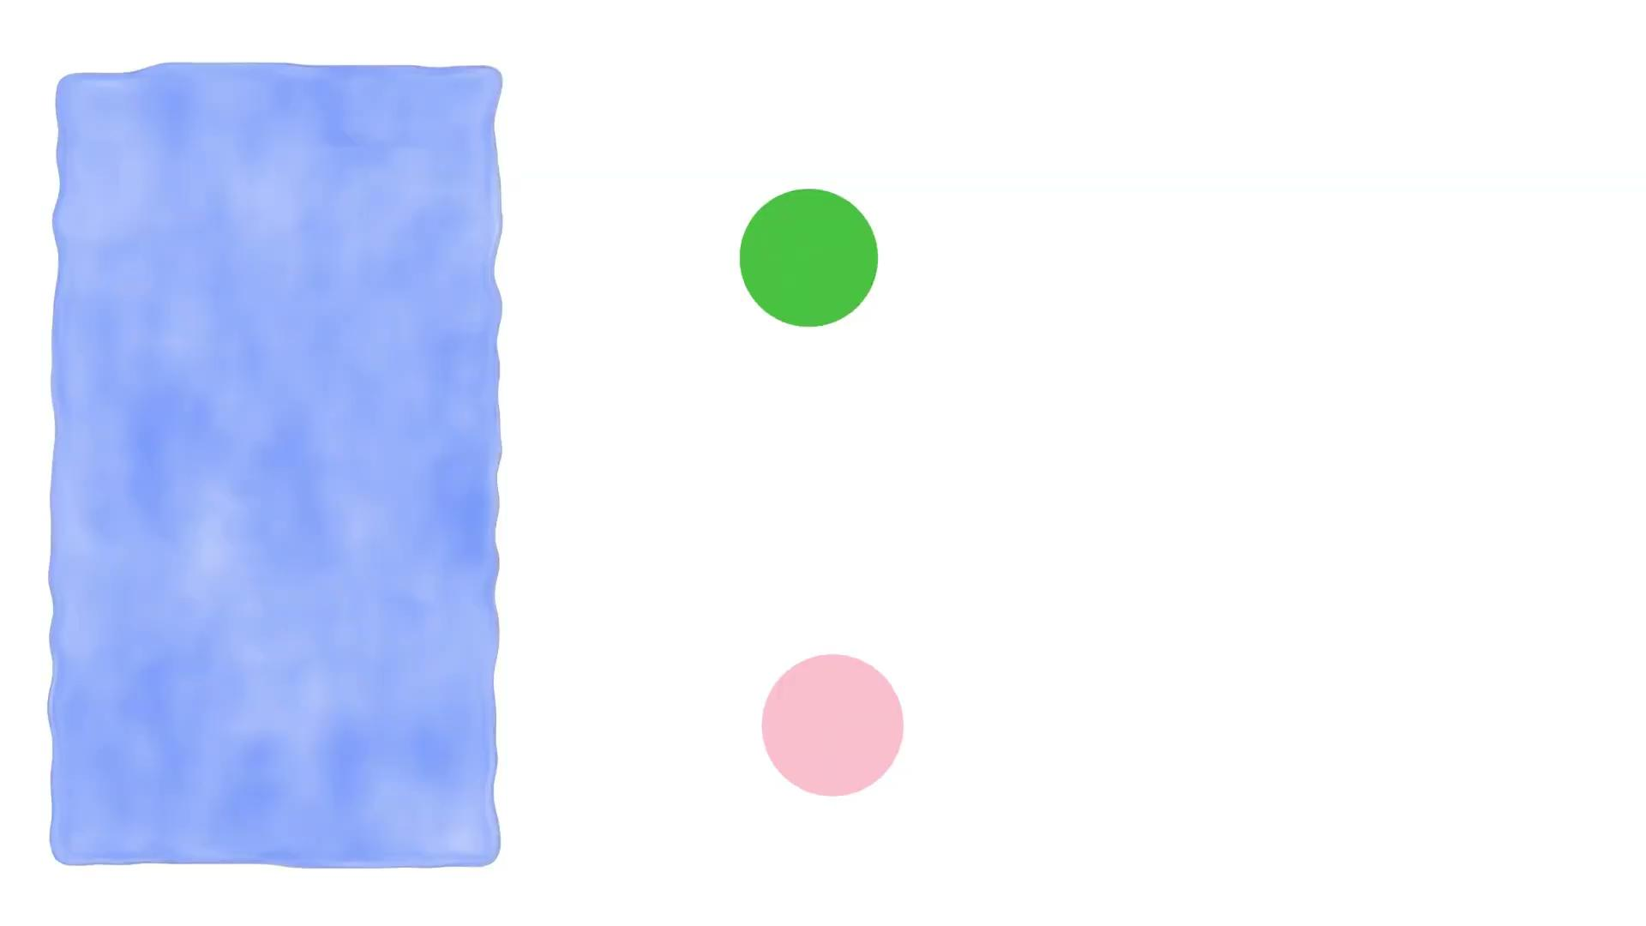
Results: Initial State Optimization
Initial
Optimized

Slide 109
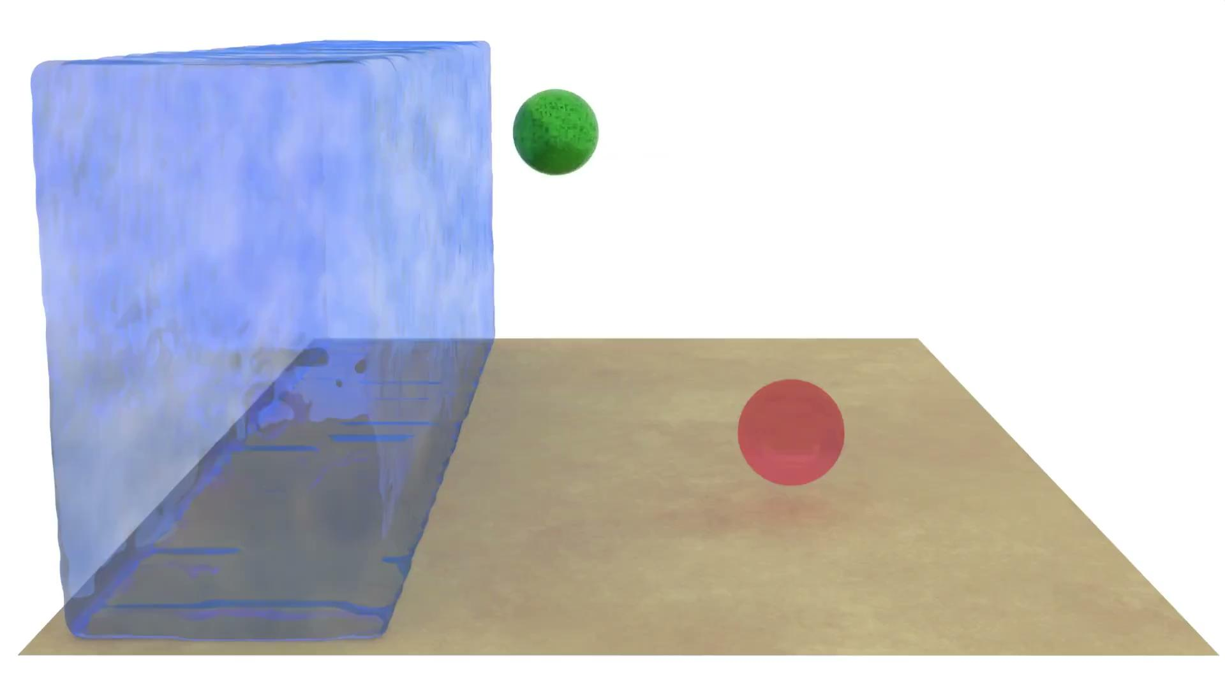
Results: Initial State Optimization
Initial
Optimized

Slide 110
Results: Optimal Control
Given the initial state, a final target location and number of simulation time steps (i.e. horizon H), learn an optimal control force sequence which guides the rigid body to the target location

Slide 111


Results: Optimal Control
Given the initial state, a final target location and number of simulation time steps (i.e. horizon H), learn an optimal control force sequence which guides the rigid body to the target location
Neural Network
Differentiable Simulator
Training Phase

Slide 112
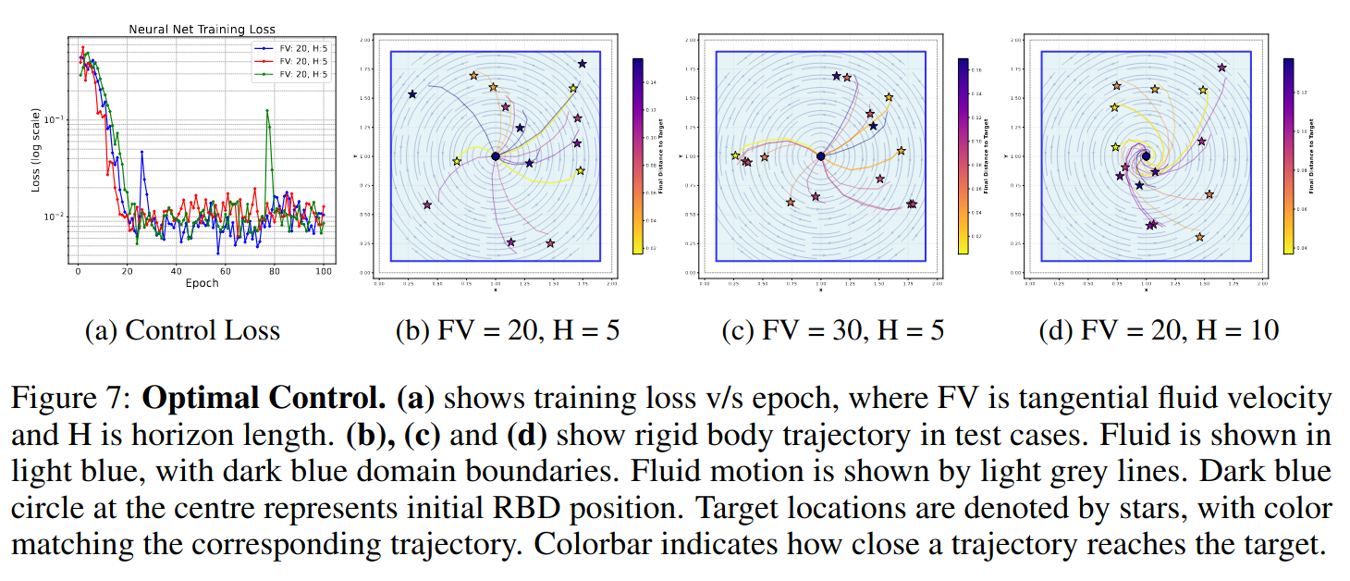
Results: Optimal Control

Slide 113
Limitations and Future Work
Simulators can only handle phenomena modeled by PDEs, unmodeled phenomena still need to be learned/inferred from data
Non-AD gradient calculations may be faster, but require a lot of manual engineering work
Discretizing the differentiation v/s differentiating the discretization

Slide 114
References
[1] Windy.com
[2] https://www.youtube.com/watch?v=79TbtomUD-o
[3] Xian et al. FluidLab: A Differentiable Environment for Benchmarking Complex Fluid Manipulation
[4] Alexey Stomakhin. The water technology behind Avatar: The Way of Water.
[5] Lesser et al. Loki: a unified multiphysics simulation framework for production
[6] Harlow and Welch. Numerical Calculation of Time‐Dependent Viscous Incompressible Flow of Fluid with Free Surface
[7] Batty et al. A Fast Variational Framework for Accurate Solid-Fluid Coupling
[8] Xie et al. tempoGAN: A Temporally Coherent, Volumetric GAN for Super-resolution Fluid Flow
[9] Wiewel et al. Latent Space Physics: Towards Learning the Temporal Evolution of Fluid Flow
[9] Sanchez-Gonzales et al. Learning to Simulate Complex Physics with Graph Networks
[10] Raissi et al. Physics-informed neural networks: A deep learning framework for solving forward and inverse problems involving nonlinear partial differential equations
[11] Brunton et al. Discovering governing equations from data by sparse identification of nonlinear dynamical systems
[12] Cai et al. Physics-informed neural networks (PINNs) for fluid mechanics: A review
[13] Holl et al. PhiFlow: Differentiable Simulations for PyTorch, TensorFlow and Jax
[14] Lions et al. Optimal Control of Systems Governed by Partial Differential Equations

